Slide 1
Time Synchronization II Rate-based Synchronous Diffusion
Balz Aschwanden
Raoul Grossenbacher
David Bösiger
Jovana Micic

Slide 2
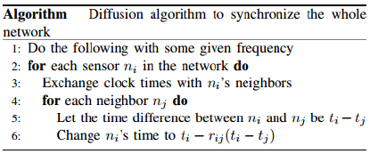
Algorithm

Slide 3
Code
Two Phases:
Neighborhood Discovery Phase
Broadcast
Convergence Phase
Unicast

Slide 4
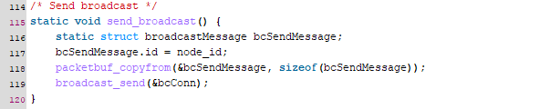
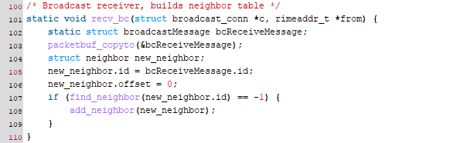
BroadCast

Slide 5
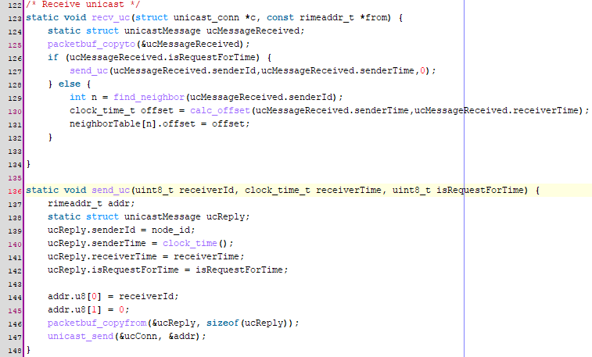
Unicast

Slide 6
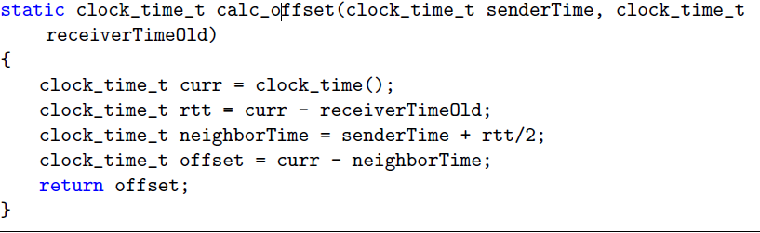
Offset

Slide 7
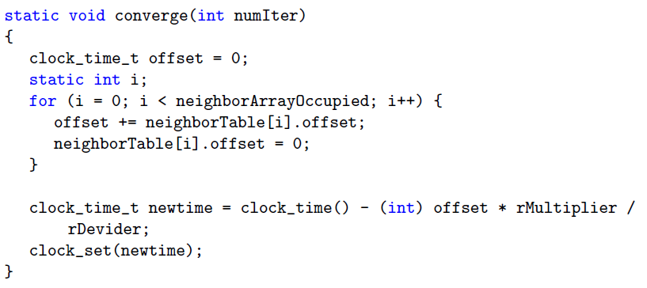
Convergence phase

Slide 8
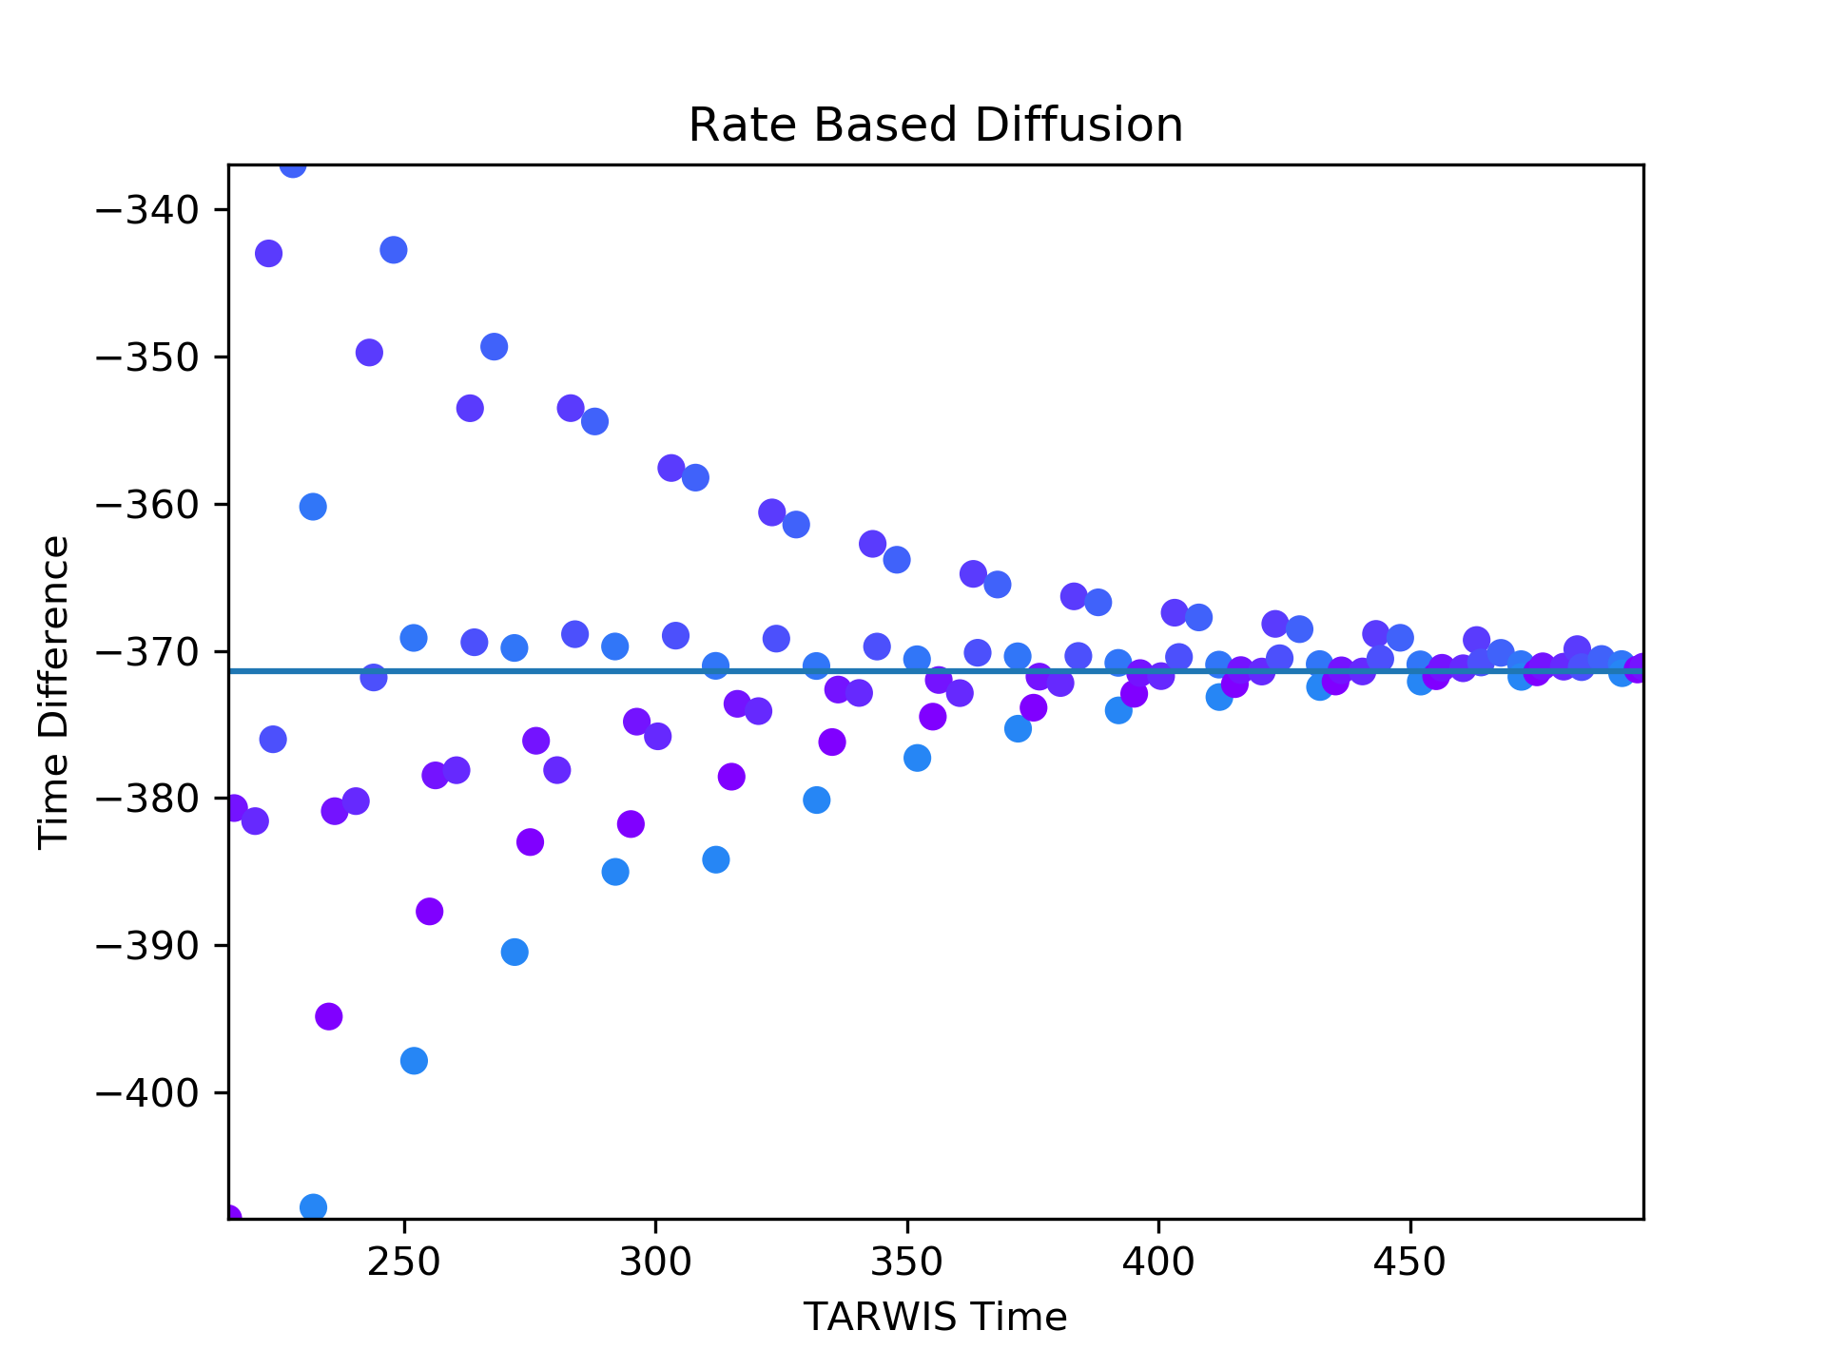
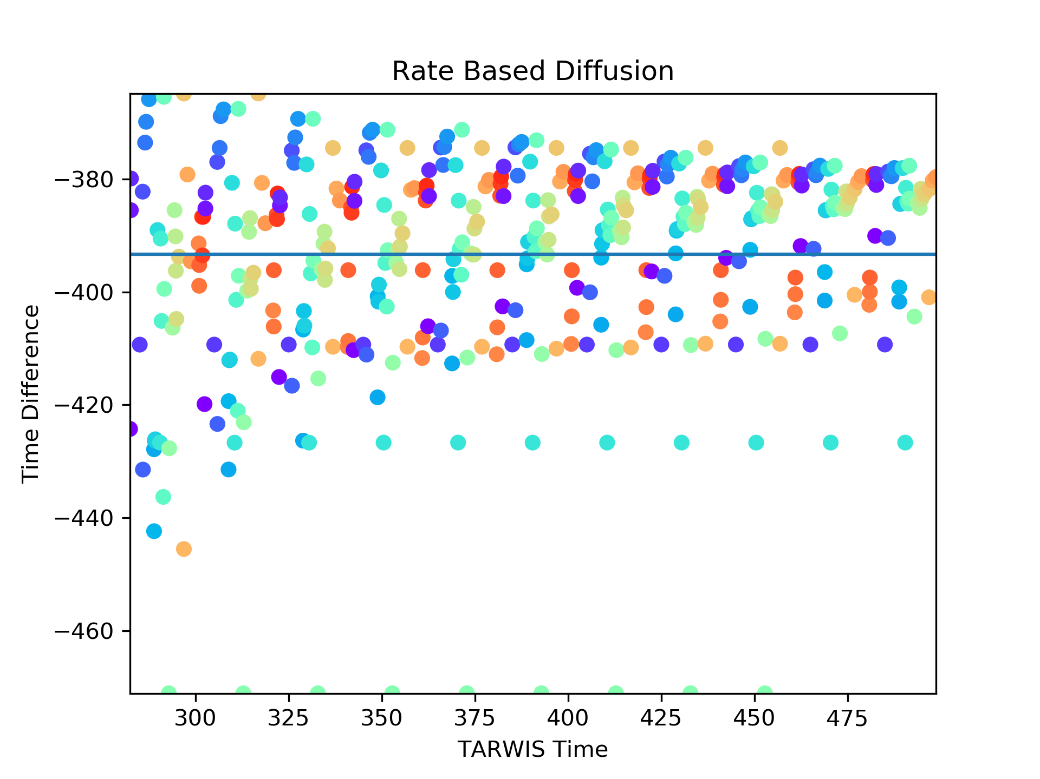
r = 0.25

Slide 9
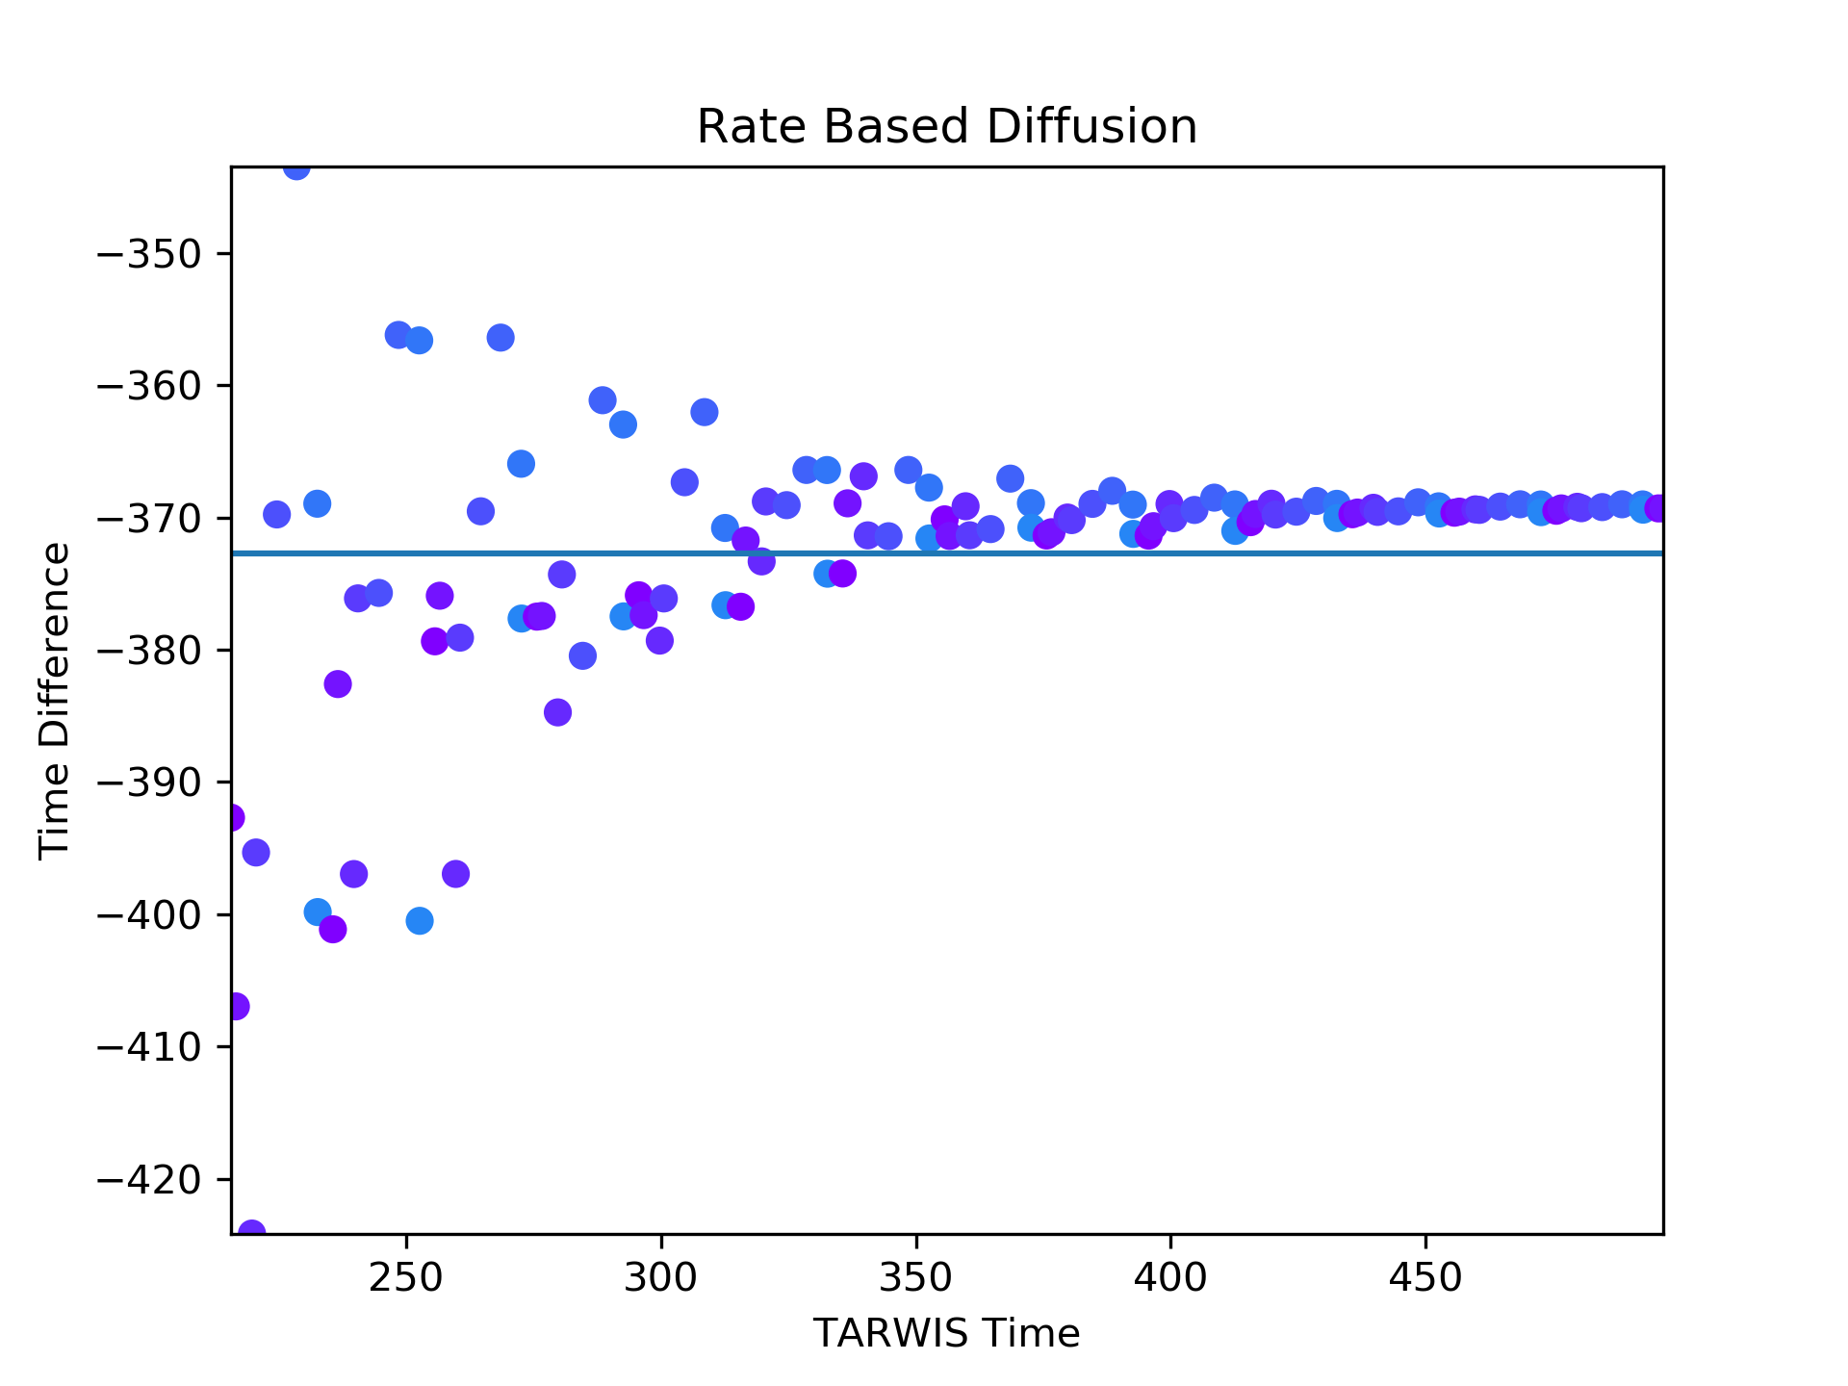
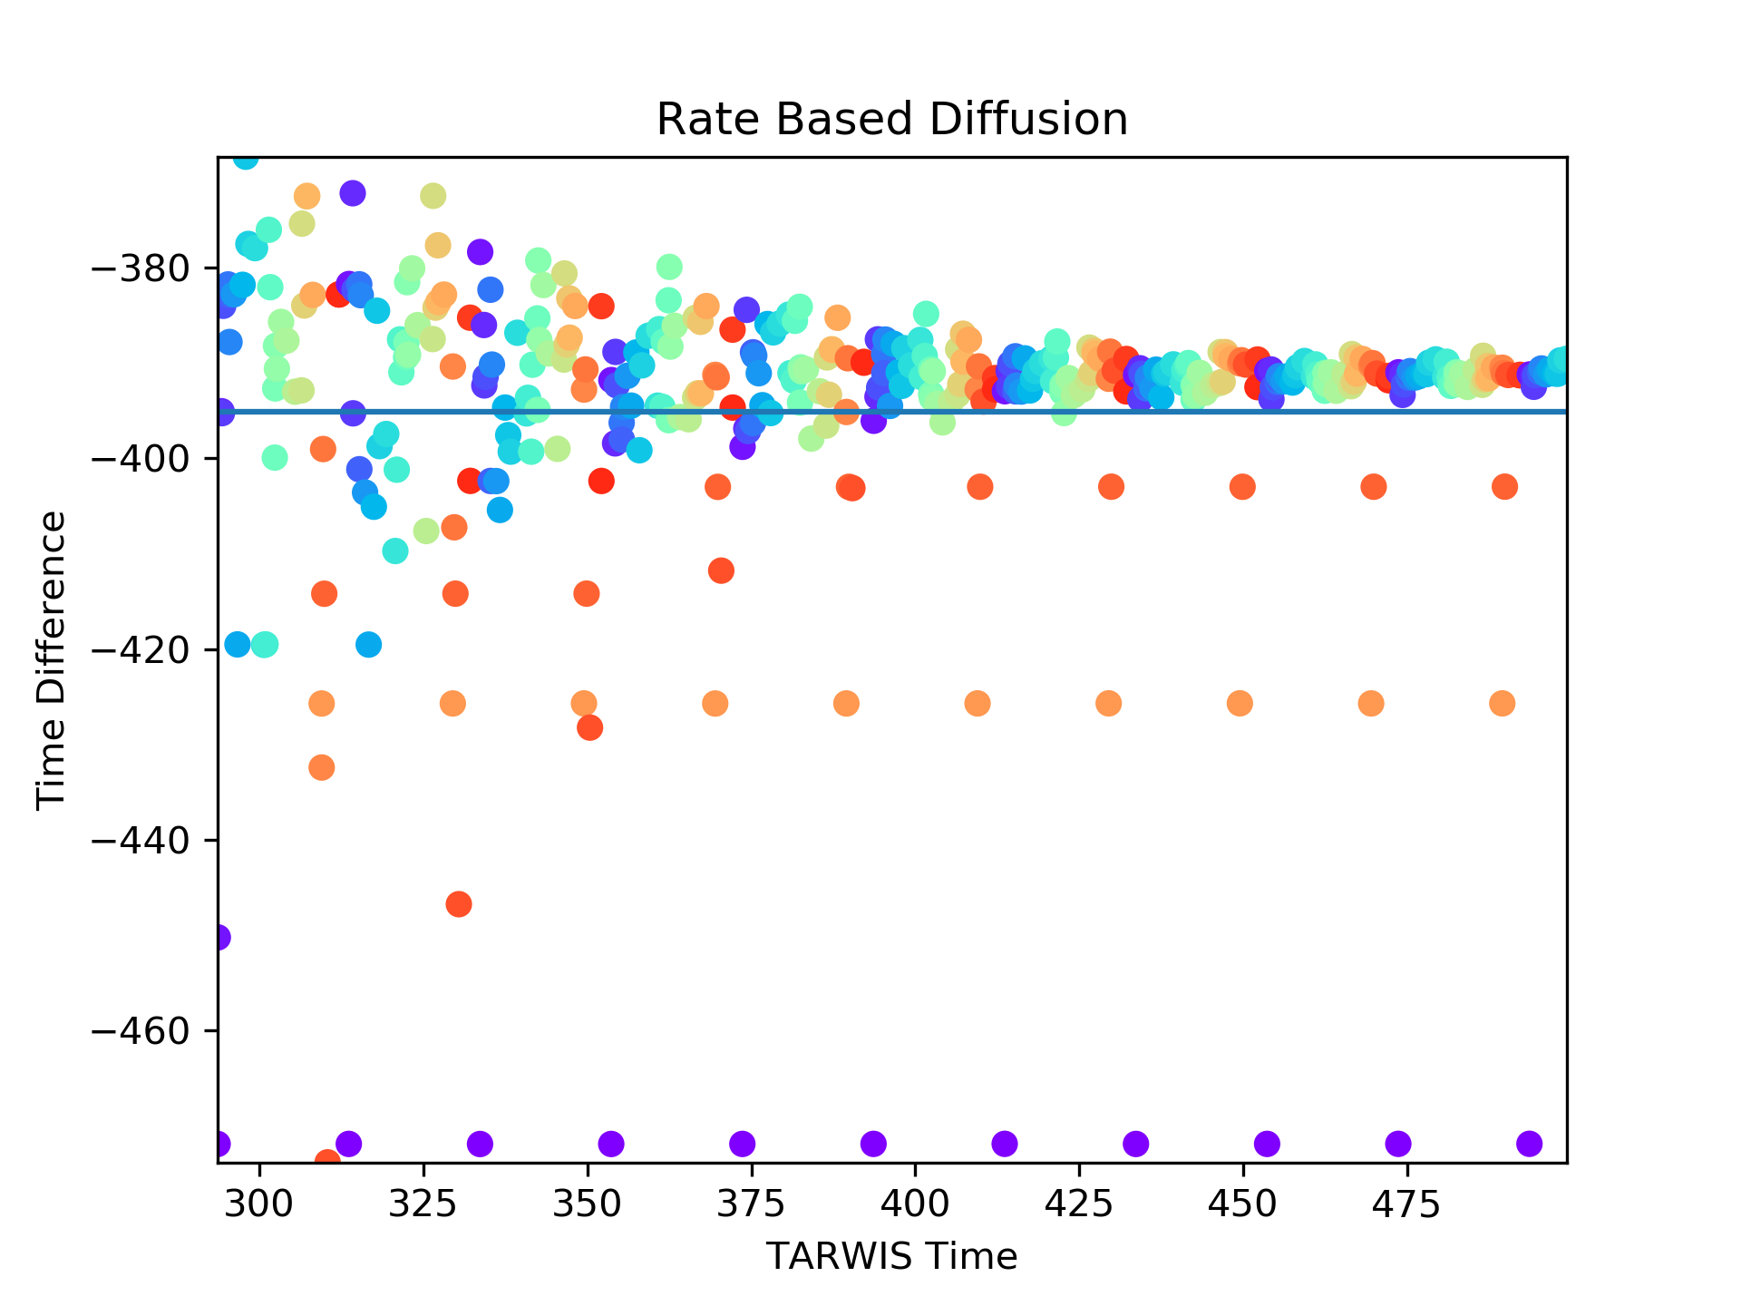
R = 0.5

Slide 10
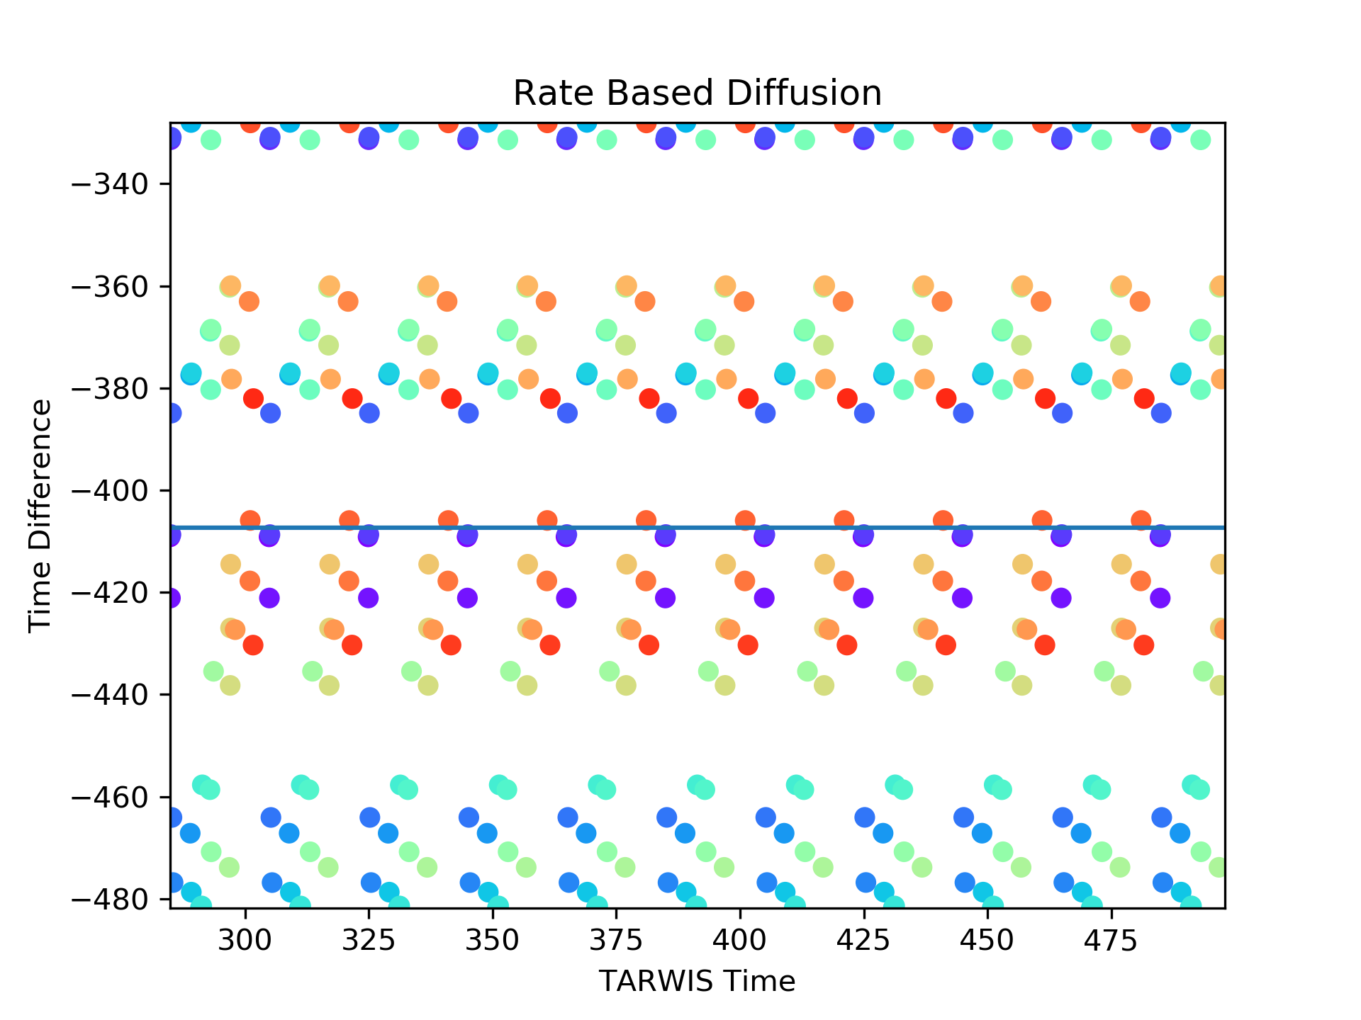
XMAC

Slide 11
qUESTIONS
Any Questions?

